Slide 1
Roundtable II
Can LNG mean Liberty with Natural Gas?
Olivier Massol (IFP School)
Mines Paris – 1 June 2022

Slide 2
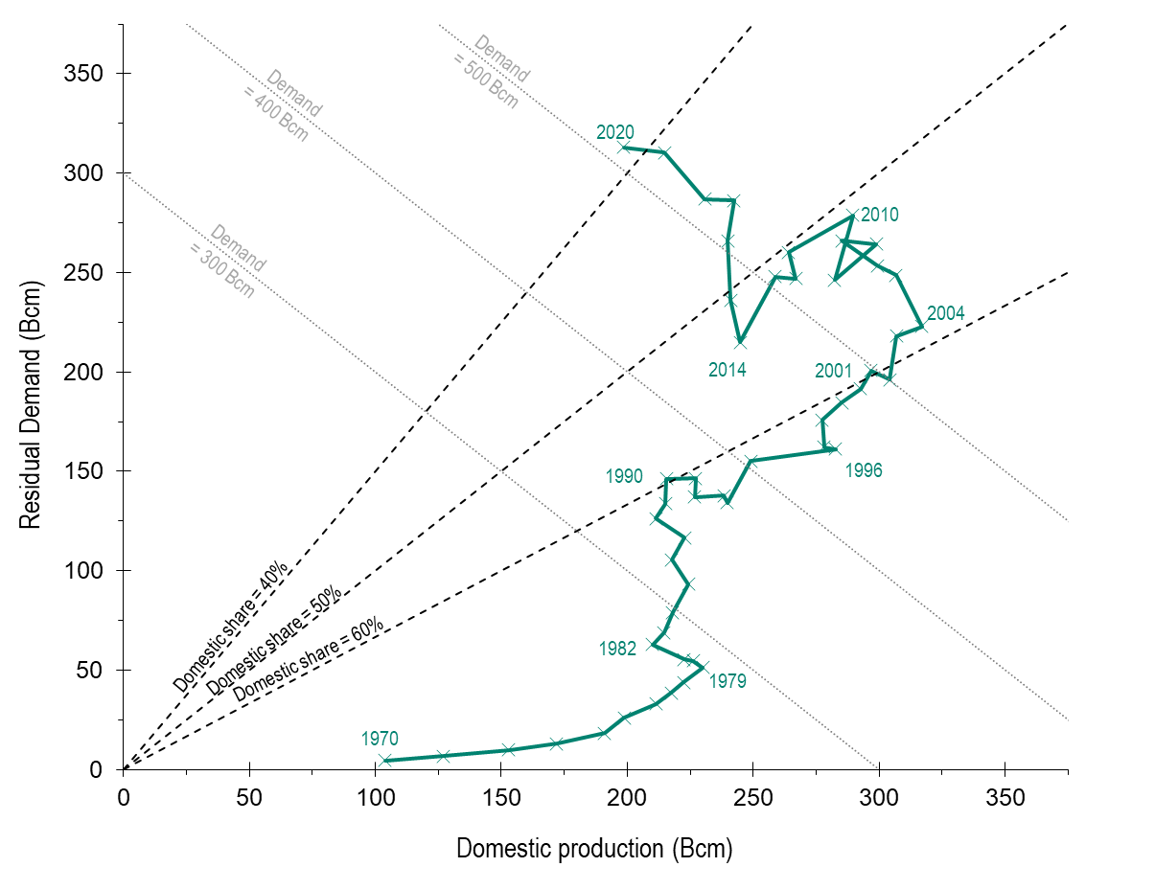
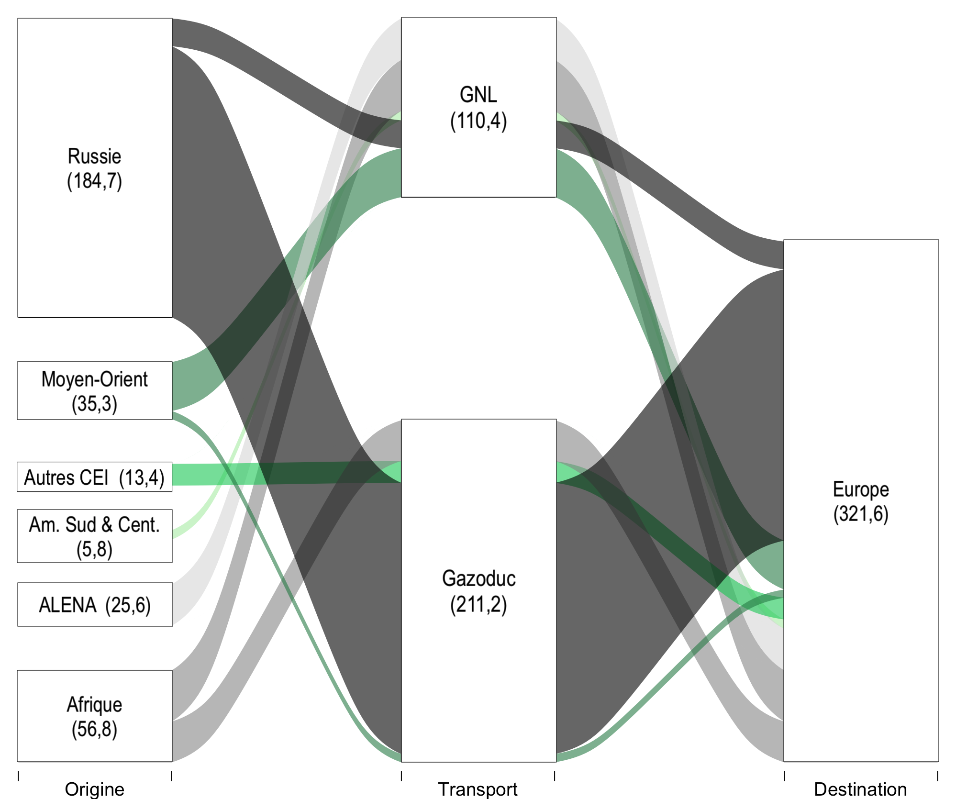
Europe mounting dependency toward gas imports
LNG
Russia
M.E
CIS
Europe
Lat. Am.
Pipeline
NAFTA
Africa
Europe: EU-27, UK, Norway, Switzerland, Serbia, Turkey, Moldovia
Source: BP Statistical Review (2021) & CEPII (2022)

Slide 3
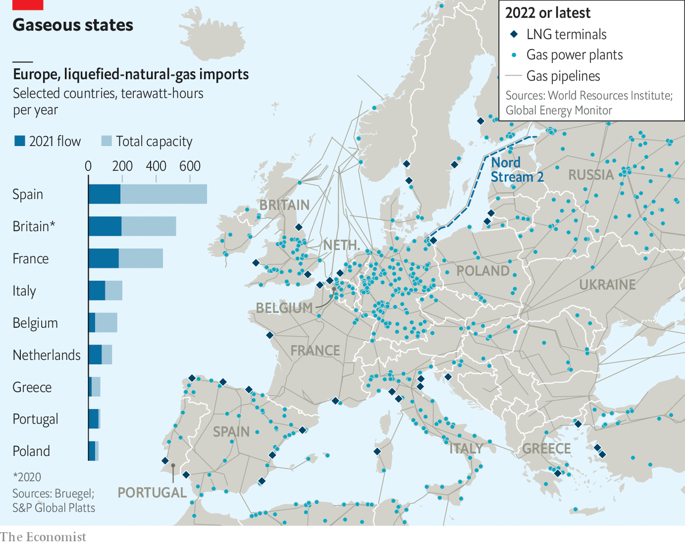
LNG Infrastructure issues

Slide 4
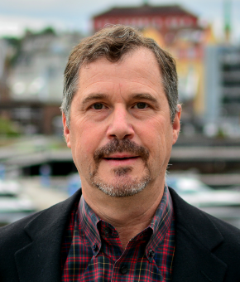
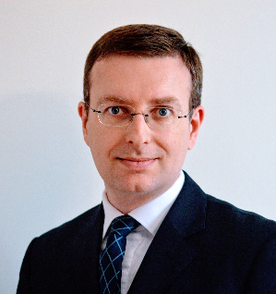
Our Panelists
Prof. Steven Gabriel University of Maryland
Mr Mike Fulwood Oxford Institute of Energy Studies
Mr Fabrice Noilhan EDF

