Slide 1
Challenges and Opportunities for Natural Gas in the Energy Transition
Ruud Egging
21 June 2019
2nd International Conference
The Economics of Natural Gas
Paris-Dauphine University
With support and material from Pedro Crespo del Granado (NTNU), Franziska Holz (DIW/NTNU), Péter Kotek (REKK), Borbála Tóth (REKK)

Slide 2
Outline
NG - main drivers and general outlook
Challenges connected to NG
Opportunities/Possible roles for NG
Methodologies
Recent Work
Research challenges

Slide 3
Main drivers and outlook

Slide 4
EU climate strategy: building blocks
Need to decarbonize
  2050: 80% electricity RES, substantial electrification, role for nuclear
energy efficiency
  Industry, buildings
transport
  Electrification, alternative fuels, better transport management.
industry
  different fuels, carbon sequestration and use.
sustainable land use
  more biomass use, enhance forests and land as sinks
infrastructure essential
  facilitate energy systems integration and digitalization, use low-carbon fuels
carbon capture and storage
  necessary notably to decarbonise industry.

Slide 5
Supply-side drivers - global
Plenty of supply, e.g.,
  Middle East conventional resources
  (US) shale gas
Increasingly more LNG exporters, and shorter distances
  Panama Channel + Northern Sea Route cut travel times

Slide 6
Supply-side Europe
Europe
  Decreasing production
  Increasing imports
  Nordstream II in progress
  Norway only remaining European exporter
  PCI projects on hold

Slide 7
Demand-side drivers
Upward
  Growing population
  Growing GDP
  Energy access
  Blue hydrogen
  Local air quality
  LNG in transport and shipping
  Need for large-scale back-up, flexibility and balancing
Downward
  Cost declines clean energy technologies
  Synthetic gas
Mixed
  GHG emissions
  Electrification
  CCS costs and acceptance
IEA, DIW, MIT

Slide 8
«Not on track for Paris» Outlooks
Gas consumption + 40-50% to about 5000 bcm by 2040
Trade grows faster than consumption, LNG even more
Europe
  only region where production and consumption decrease.
  Imports likely to increase further
  Netherlands net importer? Much reduced swing from Groningen domestically and neighboring countries.
  Norway only major producer-exporter; flat production outlook
IEA, MIT

Slide 9
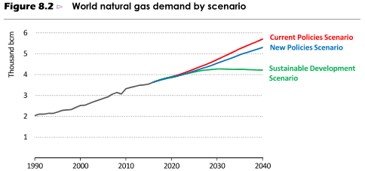
WEO2017 Three Scenarios
+45%
+15%

Slide 10
Challenges
Broader than the energy system –
Climate, societial, …

Slide 11

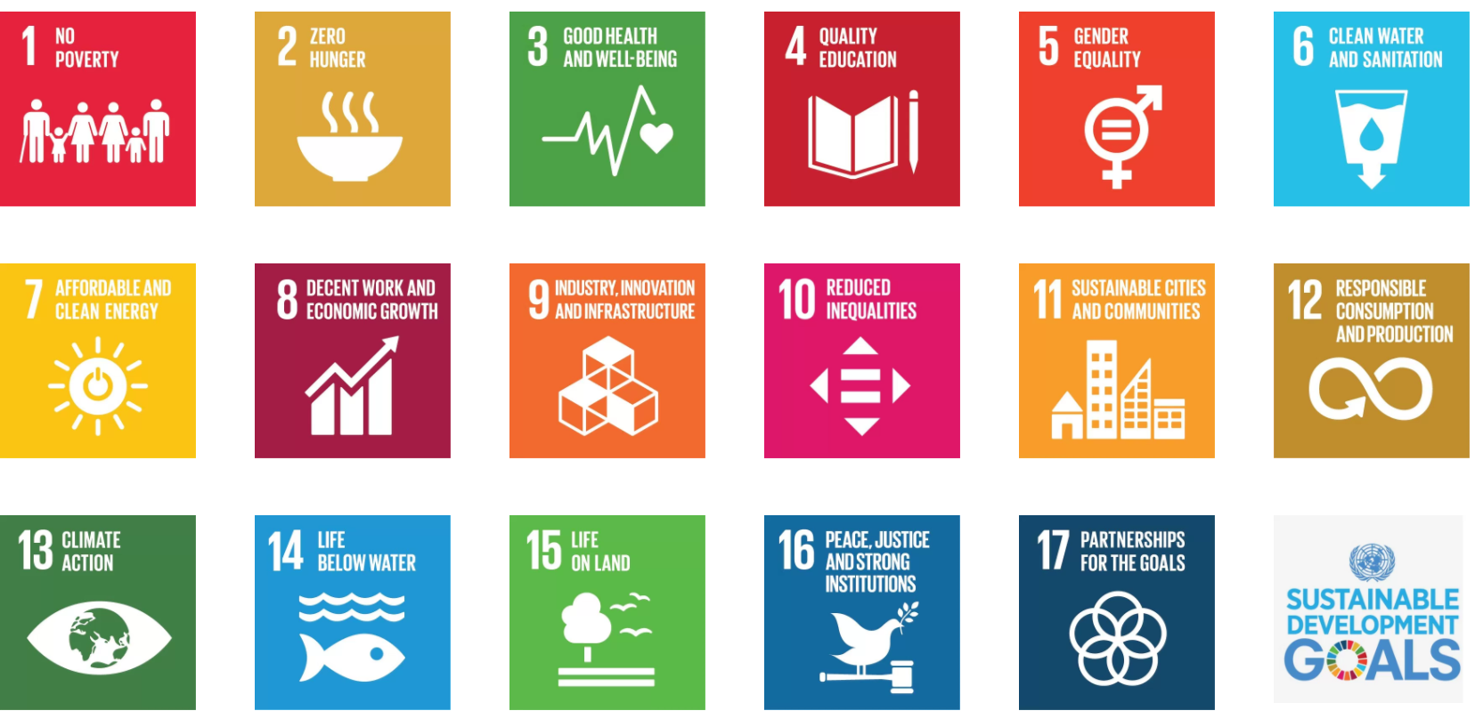
http://www.un.org/sustainabledevelopment/sustainable-development-goals/
Notes:
WEO Intro chapter 3
end poverty, protect the earth and ensure prosperity - for all.
achieving universal energy access, limitng climate change and reducing air polluton, alongside enhancing energy security.

Slide 12
The Paris Agreement
Keep global temperature increase below 2°C above pre-industrial level; aim limit to 1.5°C
https://unfccc.int/process/the-paris-agreement/the-paris-agreement

Slide 13
Energy system specific challenges
Decarbonizing and decentralization in two-three decades
  need large volumes and capacities for backup, balancing and flexibility on various time scales
Today electricity storage other than hydro reservoirs too expensive
  Biomass.. (EMPIRE 2050). Availability? C-neutral w/o CCS?
For both Hydrogen and CCS
  Value chain still immature
  Public acceptance and perceived safety
  Chicken & Egg problem *
H2: low energy content hampers competitive long-distance transport
CCS: Norway only European country with activity
CCS on quickly ramping gas-power possible. But CCS capital intensive; many operational hours – bad match with peak shaving

Slide 14
Other sectors - challenges
Industry - decarbonization:
  Feedstock
    NG for some processes preferred input. Hard to replace (by something cleaner).
  Process heat
    Heat pumps and electric furnaces need powered
  Inevitable emissions
    E.g., cement. Negative emissions elsewhere or CCS. CCS cheaper. (starting at 50-75 €/ton)
Transport – decarbonization
  Batteries are heavy / low-energy content
  Biofuels GHG impact unclear, biomass availability?
  Hydrogen… see previous
IEA, DIW

Slide 15
NG roles
Does NG have a role in low-carbon decentralized energy systems?

Slide 16
NG roles Europe – back of the envelope
Horizon Application | 2030 | 2050
Base-load power | Yes | Unlikely
Flexi power | Yes | Probably
IND - Feed stock | Yes | Probably
IND - Process heat | Yes | Probably
Building heating | Yes | Maybe
Transport | Segments | Possibly
Hydrogen feedstock | Yes | Probably

Slide 17
Boundary conditions
What is needed to facilitate roles in the energy system?

Slide 18
Boundary conditions for NG role
Application | Horizon: 2050
Base-load power | CCS Negative emissions elsewhere (NETs); eg, BECCS
Flexi power | No electricity storage break-throughs Remuneration of flexibility value CCS (?) / NETs elsewhere
Building heating | NETs elsewhere (Electrification more likely)
Transport | Negative emissions elsewhere
CH4+CCS=H2 | acceptance a market and infrastructure CCS
+ level-playing field for technologies considering all external effects including adequate market designs and
timely and reliable policy environment

Slide 19
NG and other energy carriers increasingly connected / integrated: analyses need wider scope than traditional models with single sector perspective can provide

Slide 20
MethodologY - MODEL LINKING

Slide 21


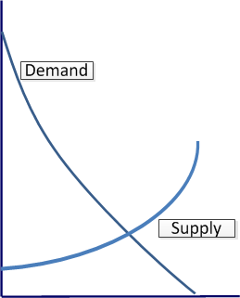
Three of the main model types
I.A.M.
C.G.E.
P.E.
Integrated Assessment Model
Computational General Equilibrium
Partial Equilibrium
Pix credit: Dreamstime.com

Slide 22
Characteristics of some model types used for policy support and analysis
 | IAM | CGE | P.E.
Perspective | Holistic | Economy | (Energy) sector
Metrics and relations | Aggregate economic, technical & physical | Aggregate economic | Detailed economic & physical
Climate | + | - | -
Environment | + | - | -
Carbon cycle | + | - | -
Land use & forestry | + | - | -
Oceans & water | + | - | -
Economy & trade | + | + | -
Spatial detail | - | + | +
Technical detail | - | - | +
Temporal detail | - | - | +
For illustration only

Slide 23
Let each model type do what it’s good at
Isolated
  Define consistent parameterizations for all models
  Run models
  Results inconsistent due to underlying assumptions
Integrated
  Develop one model combining all strengths of all models
  Necessarily sacrifice detail to maintain tractability
(Soft / Hard) Linked
  Decide relative strengths of each model and which (exogenous) inputs are based on (endogenous) outputs of others
  Define consistent parameterizations
  Iteratively run models and exchange data until results are consistent

Slide 24
Linking models - why
No single model can covers all aspects in all desired detail.
Need consistent & coherent quantitative representations across models to analyze scenarios
Models have different
  Approaches
  Foci: strengths & weaknesses
  Scopes, scales / granularities & information structure
  Exogenous (parameters) vs endogenous variables / boundary conditions
  Physical vs monetary representation; units of measurement
  →Features give complementary strengths but pose challenges for exchanging data
One model’s results are another’s boundary conditions

Slide 25
Using relative strengths:
Climate
Land use
Global trade
Emission ceilings / costs
Energy demand
I.A.M.
C.G.E.
P.E.
Outputs
Prices
Energy prices

Slide 26
Challenges when linking models:
Differences in
  Granularity (level of detail)
    Spatial
    Temporal
    Technical
  Scope
  Units of measurement
  Underlying assumptions
Version control
Convergence

Slide 27
Linking models – how?
Middleware
  all models exchange with one central DB:
  Reduce number of links from M(M-1) to 2(M+2)
Upfront agreement on
  Technical, Spatial, Temporal resolutions
  Standardized data table formats
  Units of measurement
  Unique identifiers for data sets and entries
  Documentation of data
Automated scripts for hard-linking

Slide 28
IIASA data exchange platform
Inputs and results
https://data.ene.iiasa.ac.at/set-nav/

Slide 29
Decarbonization EU ENERGY SYSTEM – impact ON GAS

Slide 30

H2020 SET-Nav
April 2016 - March 2019
SET-Nav EC H2020
grant 691843
Navigating the Roadmap for Clean, Secure and Efficient Energy Innovation

Slide 31



The SET-Nav project has received funding from the European Union’s Horizon 2020 research and innovation programme under grant agreement no. 691843 (SET-Nav).
Case Study 7.4: Unlocking flexibility and synergy in electric power and natural gas supply systems
Pedro Crespo del Granado, Christian Skar, Hector Marañon Ledesma (NTNU); Blazhe Gjorgiev, Giovanni Sansavini, Andrea Antenucci (ETH Zurich); Luis Olmos, Quentin Ploussard, Sara Lumbreras, Andres Ramos (Univerisidad Pontificia Comillas)

Slide 32
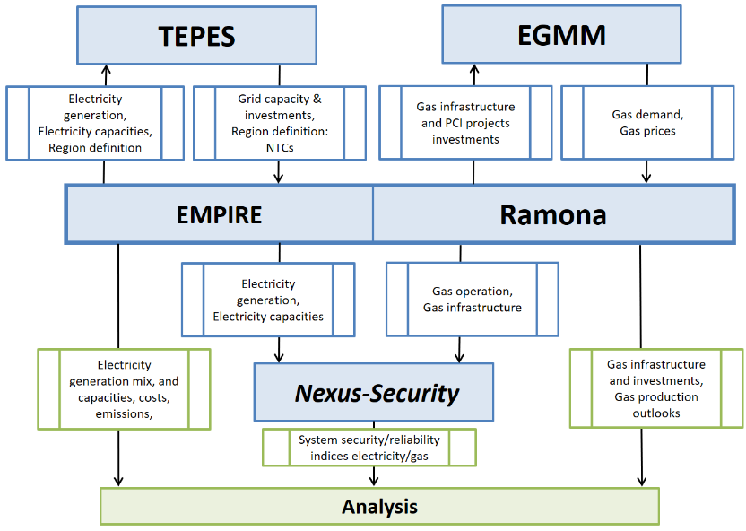
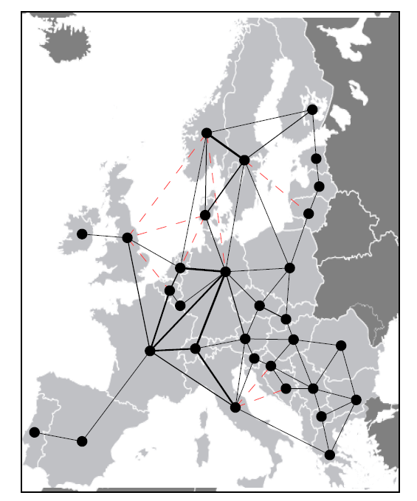

Modelling framework

Slide 33

Cases
All models calibrated to PRIMES decarboniz scenario (E3MLab & IIASA 2016)
Nuclear restricted [current cap levels; no replacement]
No CCS
Flexi-Grid - Transmission
  Transmission expansion allowed (Electricity)
  EMPIRE: intra-day demand response + curtailment
  → Grid expansion & hydro main sources flexibility
Flexi-1 – electricity storage
  Transmission is restricted [current levels + 10Y ENTSO-E NW plan]
  → More electricity storage and gas thermal plants.
Flexi-2 – gas infrastructure
  Transmission is restricted
  Electricity storage expensive
  Demand response (current levels)
  → Gas thermal plants main flexibility provider.
E3MLab and IIASA (2016). Technical report on Member State results of the EUCO policy scenarios. EUCO 27
scenario. Energy Modelling, European Commission. https://ec.europa.eu/energy/en/data-analysis/energy-modelling

Slide 34
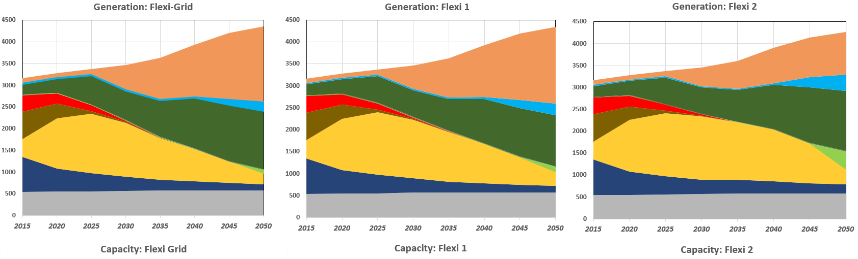
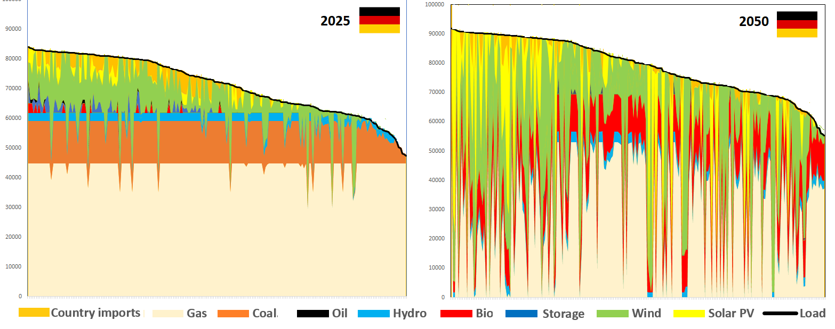
EU power generation mix
solar pv
lignite
w-offs
coal
wind onshore
gas
nuclear
hydro
Gas primarily base-load in 2025; in 2050 balancing.
Utilization 64 (+/-1)% in 2025; 15% in 2050.

Slide 35
PATHWAY ANALYSIS
THE ROLE OF NATURAL GAS
IN AN ELECTRIFYING EUROPE
Coauthors: Péter Kotek, Borbála Tóth (REKK), Franziska Holz (DIW),
Pedro Crespo del Granado (NTNU)

Slide 36
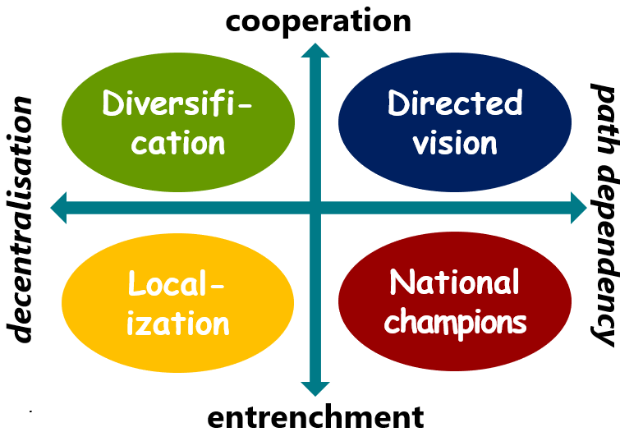
Pathways

Slide 37
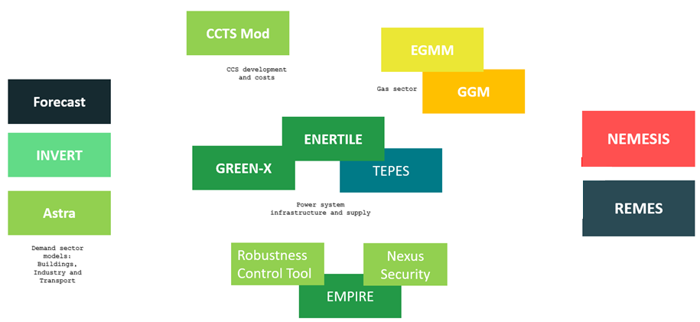
Models
Demand sector models:
Buildings, Industry and Transport
Supply and Infrastructure models:
Power system, transmission grids, heat grids, gas sector and other incoming technologies (e.g. CCS and hydrogen)
Macro Economic models
Egging 2019 - Paris - NG in the European ET
37

Slide 38
SET-Nav Patways Sector models + PRIMES Ref: EU Gas demand development (BCM/y)
Decarbonization – gas demand in:
Transport: up
Industry: down
Building heating: down
Power generation: down
1 bcm = 1 billion m³ = 11.4 TWh = 0.9 Mtoe
38
Egging 2019 - Paris - NG in the European ET
38

Slide 39
Gas demand development in the pathways (BCM/y)
50% - 75% decrease
1 bcm = 11.4 TWh = 0.9 Mtoe
39
Egging 2019 - Paris - NG in the European ET
39

Slide 40
EGGM (REKK)
GGM (NTNU/DIW)
Europe + neighbors
Exogenous demand, supply and capacities
Pipelines, storages, LNG regasification
Monthly resolution
2015-2050
Bio-methane in 2 pathways
Main outputs: gas prices, infrastructure utilization, market agent profits
Global
Calibrated demand, exogenous (initial) capacities
Pipelines, storage, liquefaction, shipping, regasification
Three seasons, 5-year steps
2015-2050
Endogenous demand, supply, capacity investment, utilization, profits

Slide 41
EU28 import dependency (REKK EGMM model)
(Relative) import dependency stabilizes or decreases
In scenarios with significant RES-gas, dependency decreases drastically
41
Egging 2019 - Paris - NG in the European ET
41

Slide 42
infrastructure Utilization pipelines from Russia (bcm/y) (NTNU DIW GGM model)
Yamal Nordstream Turkstream Brotherhood
42
Egging 2019 - Paris - NG in the European ET
42

Slide 43
infrastructure Utilization pipelines from Africa (bmc/y)
Maghreb+Medgaz Galsi Greenstream TransMed
43
Egging 2019 - Paris - NG in the European ET
43

Slide 44
infrastructure Utilization pipelines from Russia (bcm/y)
44
Egging 2019 - Paris - NG in the European ET
44

Slide 45
infrastructure Utilization regasification (bcm/y) GGM
45
Egging 2019 - Paris - NG in the European ET
45
Notes:
Peter/Borbala: GGM does not foresee any LNG imports after 2035. What is driving EGMM LNG imports? contracts, other assumptions? Are there some high load months when they occur?
We have global LNG oversupply in the assumptions. Depending on the scenario, if EU production is not substituted with domestic EU RES gas and Russia does not utilize the Ukrainian grid for transit, the missing volumes are substituted from the LNG. We also have some LNG contracts, but this is not the main driving factor.

Slide 46
Effects on TSOs
Operational income drops by ¾
Upward pressure on tariffs
  May further reduce competitiveness
Decommissioning pipelines
  may distort SOS; possibly not critical when gas share
  in primary energy so low (?)
46
Egging 2019 - Paris - NG in the European ET
46
Notes:
Peter/Borbala: what is IP?
Interconnection Point. Points of infrastructure connecting the TSO-TSO areas. IP related revenue refers to the revenues of TSOs realized on the borders (as opposed to storage, production and distribution points).

Slide 47
Effects on storages
Without decarbonisation, need for storage grows
  Reference 2020 52 bcm/y → 2050 64 bcm/y (+23%)
In scenarios storage usage decreases 50%-75%
  Scenarios: 2050 15-25 bcm/y
  Based on monthly loads, not accounting for intermittency “backup”
47
Egging 2019 - Paris - NG in the European ET
47

Slide 48
Additional notes
Upward pressure on infrastructure usage tariffs may further reduce gas usage, etc.
Decommissioning & stranded assets?
Gas models have not considered minimum flows and volumes
Gas routing & maintaining pressure in structurally low throughput situations?

Slide 49
conclusion

Slide 50
Role for NG in European energy
Do we still need gas after 2040? No (!)
Decarbonization is not our only mission: “100% Renewables” may be the right answer, but it is the wrong question.
Consider NG as part of the future energy mix? Yes
Not considering NG (and CCS) in the transition or as constituents of a low-carbon future energy system may be very expensive.
Keep all options open and aim at a level-playing field with fair incentives pricing in all external effects ranging from climate and health impact to flexibility and security of supply

Slide 51
Research agenda
future energy system will rely on much broader range of energy supply and transportation technologies
will allow and need more tailored solutions
planning and management much more complex.
Deterministic annual / seasonal average loads will become meaningless metrics.
Gas market / system research will have to explicitly account for much lower time-scales and connect / link to other parts of the energy system
  Sector linkage, carrier substitution, time-scales
  Gas system supporting energy transition
Market design and incentives accommodating new roles

Slide 52

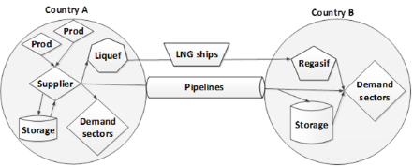

Some links:
SET-Nav reports, papers, briefs…
  https://www.set-nav.eu
GGM is now open access
  https://www.ntnu.edu/web/iot/ggm
  Model code and data + documentation
NTNU Energy Transition Initiative
  research on transition strategies to a sustainable energy system and low carbon society.
  https://www.ntnu.edu/energytransition
openENTRANCE 2019-2023
  H2020 EU project – SET-Nav II - focus on open model & data
Norwegian Research Council NTRANS 2019-2027
  Energy Transition Strategies –
  Social acceptance and behavioral aspects

Slide 53
Thank you
ruud.egging@ntnu.no
Notes:
ntnu page
research gate
repec

