Slide 1
Why Nord Stream 2 ?
  Chair “The Economics of Natural Gas”
  Paris Dauphine University
  21st of June 2019
Notes:
Thank you for your invitation to discuss NS2
Within Engie I am in charge of gas supply activities for Europe. We are supplying nearly 10% of the internal EU gas demand in 17 countries.
We are supporting NS2 because we think this project if of strategic importance for the European gas industry

Slide 2







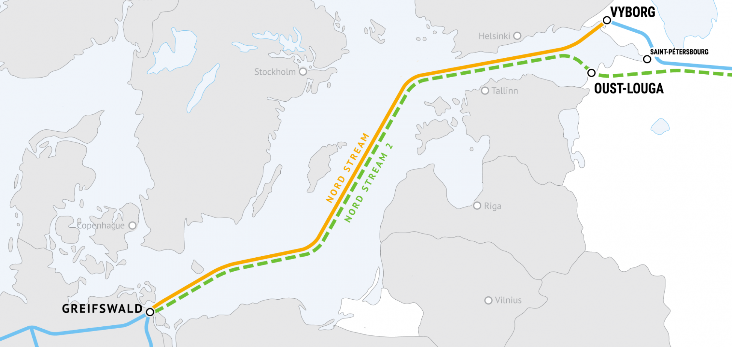
Nord Stream 2
A fully privately funded project
100% Shareholder
Project Developer
Financial Investors
8 bn € CAPEX
9.5 bn € total expenditure
(including financing costs)
support the project
by providing up to
50 % of the financing,
up to 950 Mn € each
provides up to 50 % of the estimated project cost

Slide 3
Project update
Over 1 400 km (~ 57%) of pipeline completed so far
All 2 473 km of pipes delivered and 94% concrete coated
Work on German and Russian landfalls progressing to schedule (civil engineering and infrastructure, offshore connections, installation of valves…)
Almost all of the project CAPEX, amounting to 8 bn€, have been contractually committed in investments in European industry and services involving over 670 companies from 25 countries.
More than 5.8 bn€ already invested.
Notes:
At what stage are we.
Good progress in terms of implementation.
…
All permits so far obtained except Danemark that could try to delay the project.

Slide 4
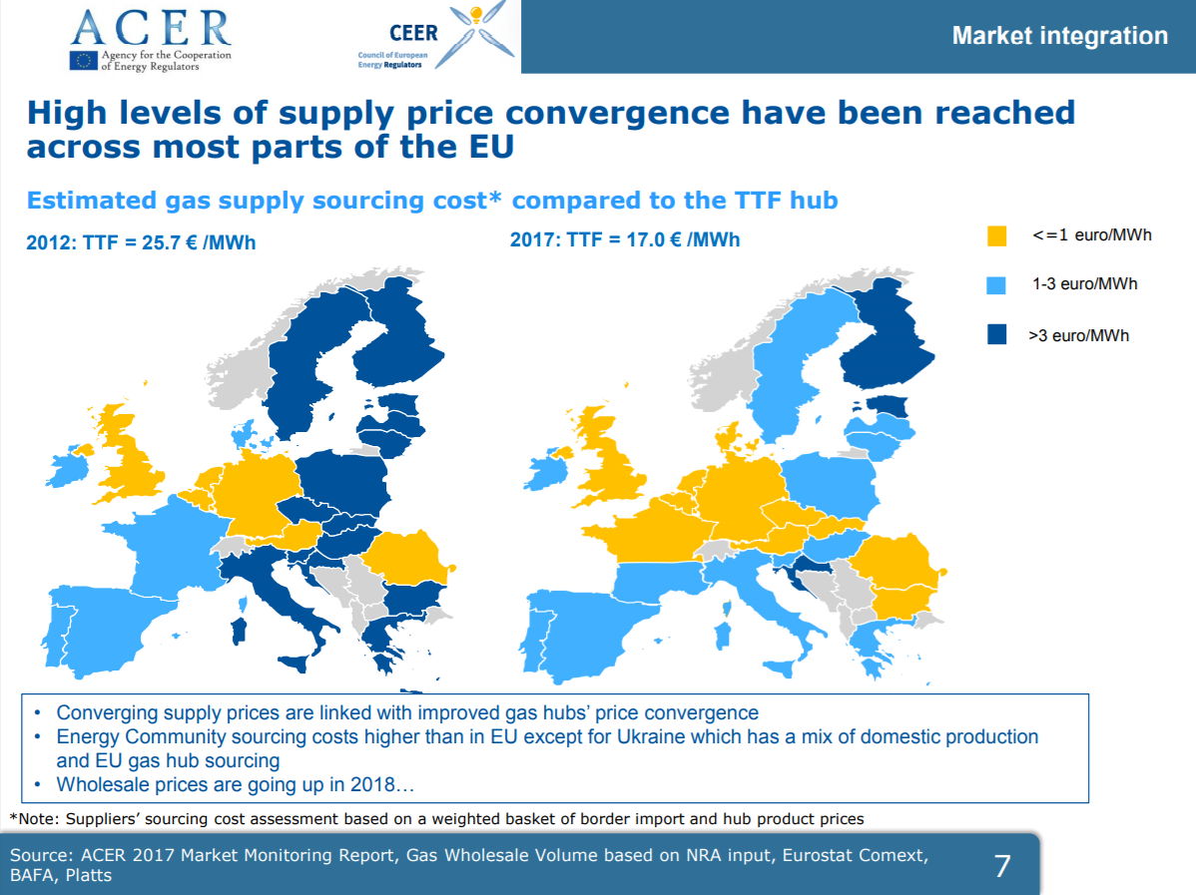
European energy policy led to strong market integration
European gas markets are well-integrated and make prices converge regardless supply source
European gas markets are resilient :
Gas is circulating easily across European countries
Gas is stored in quantity to face extreme events like very cold winter, supply disruption,
Notes:
+27% of transportation capacities from 2009 to 2015

Slide 5
Europe will rely more on more on Natural Gas imports
521
544
+4%
+7%
428 bcm
240 bcm
296 bcm
-9%
-48%
Sources : ENGIE Market Analyst
Depletion of indigenous production (North Sea and Netherlands)
Failure to develop shale gas (Ban in some countries, no success in others)
Supply gap will increase by 50% in 12 years : to be filled by Pipe gas and LNG
Notes:
Explain stability of demand.

Slide 6
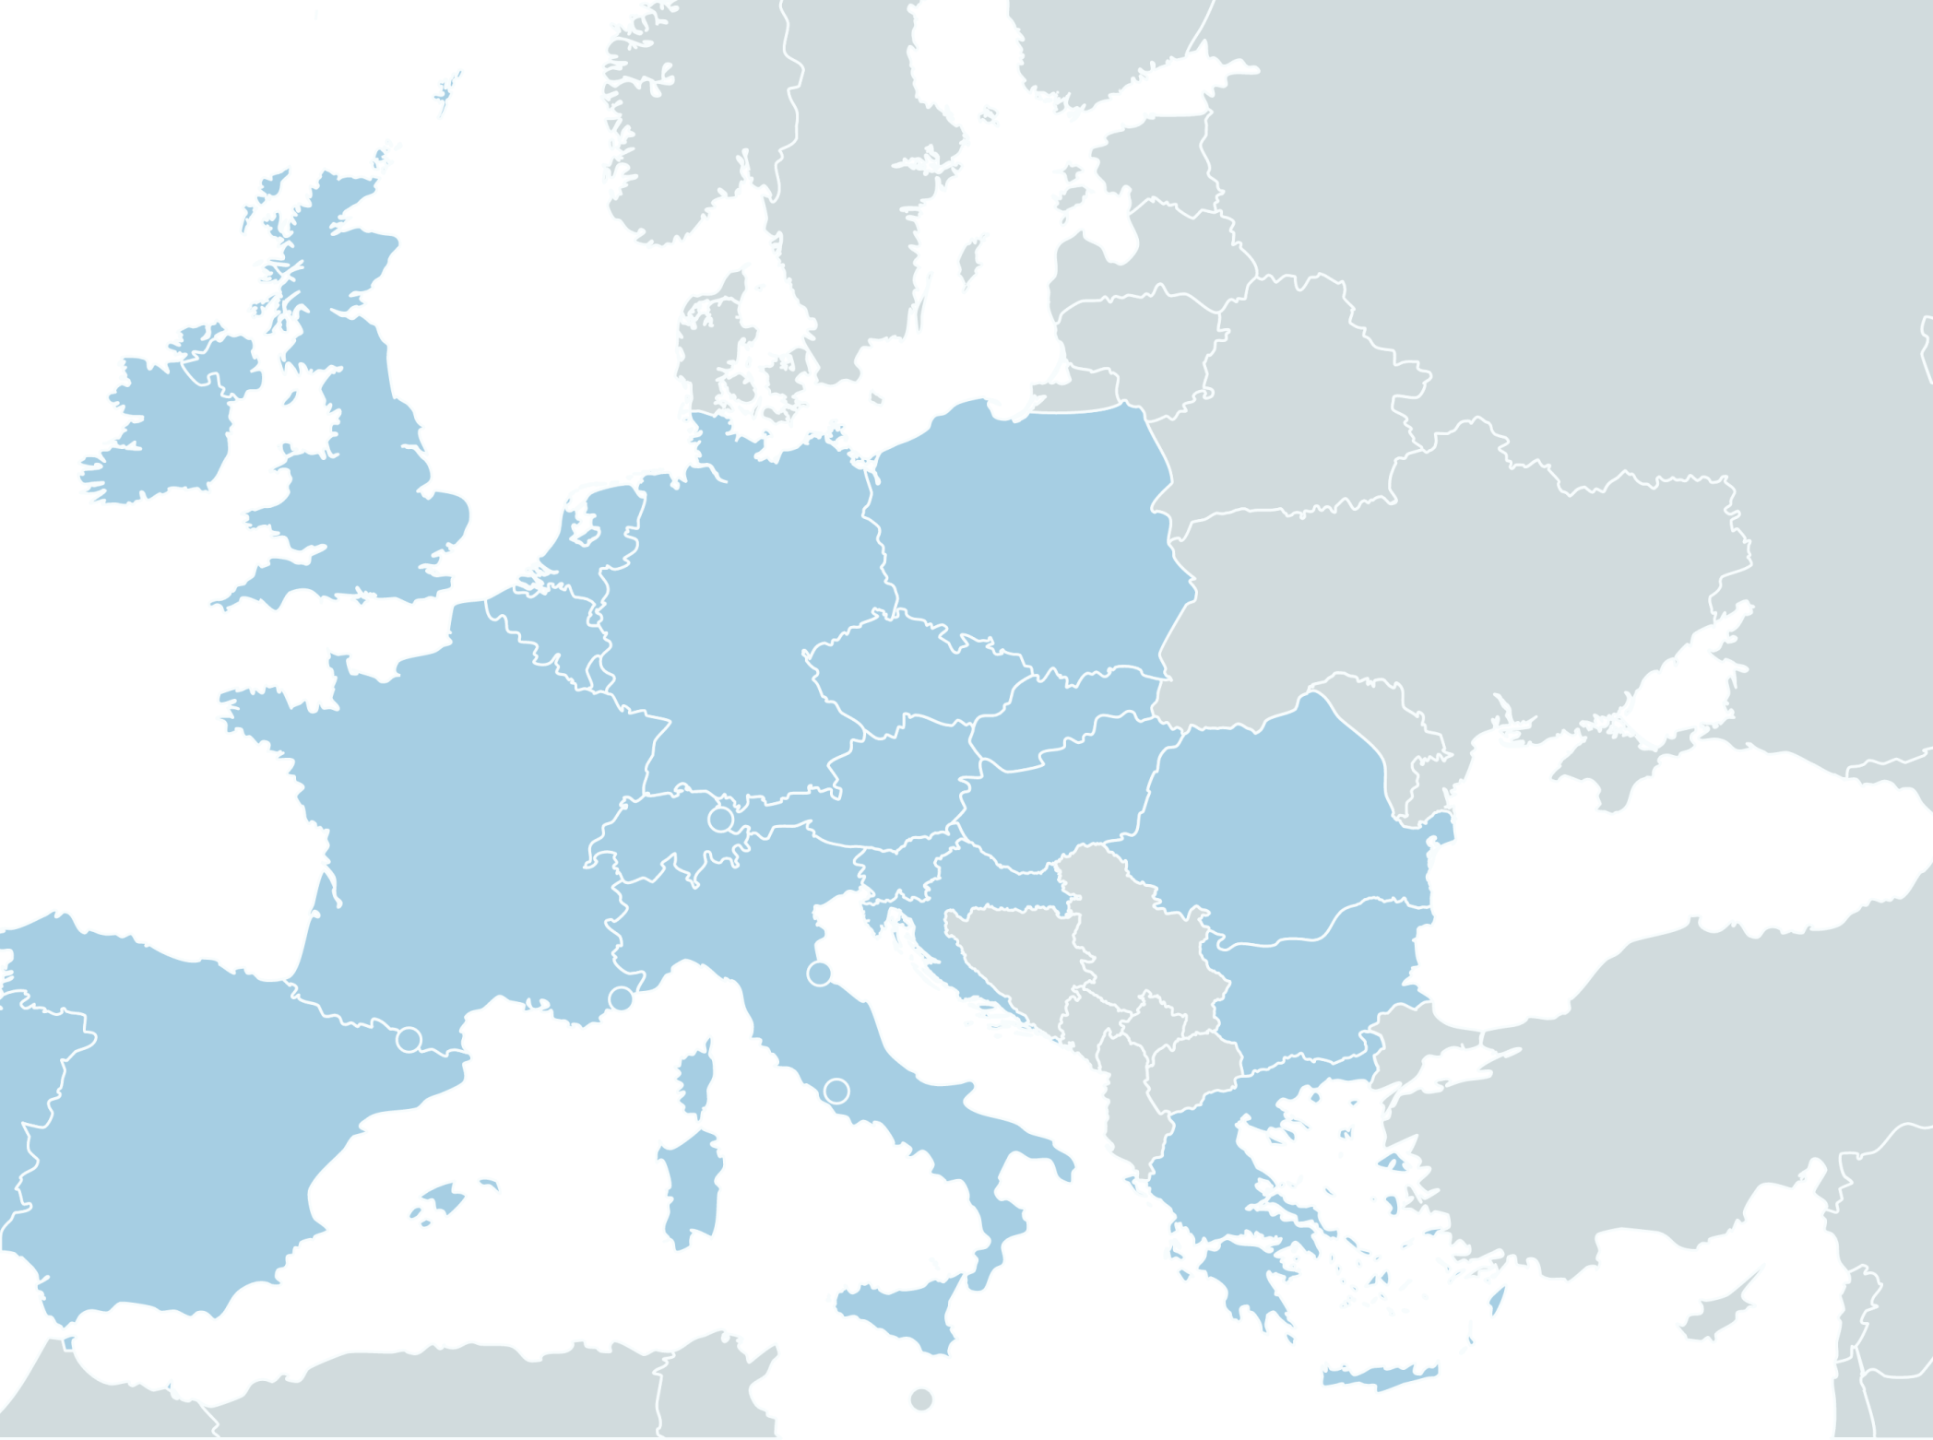
IN OPERATIONS
Nord Stream 1
NEL
OPAL
Yamal-Europe
Ukrainian Transit
Blue Stream
Medgaz
MEG
Transmed
Green Stream
CONSTRUCTION
TANAP
TAP
Turkish Stream
COMMITTED
Nord Stream 2
PROJECT
HUSKAT
ROHU
Baltic Pipe
EUGAL
EASTMED
LNG Terminal
Nord Stream 2
55 Bcma
Nord Stream 1
55 Bcma
Norwegian Pipes
Baltic Pipe
10 Bcma
Yamal-Europe
33 Bcma
NEL
20 Bcma
Ukrainian Transit
146 Bcma
OPAL
35 Bcma
EUGAL
51 Bcma
HUSKAT
5.2 Bcma
ROHU
4.4 Bcma
Blue Stream
16 Bcma
Turkish Stream
31.5 Bcma
TAP
10 Bcma
EASTMED
10 Bcma
TANAP
16 Bcma
Transmed
30 Bcma
Medgaz
8 Bcma
Green Stream
11 Bcma
MEG
12 Bcma
Notes:
Possible options to fill the supply gap
Black Sea: max 20 bcm/y of production but Romania is reluctant to be interconnected with the rest of Europe
East med: 12 bcm/y as a first stage and then 21 bcm/a but preferred option is LNG
North Africa : 10 Bcm/y Algeria and Libya but very uncertain & unstable
Middle East: up to 50 bcm/y
Azerbaijan (16 bcm/y) but some doubts on the possibility to do more
Iran but foreclosed market with US sanctions
Turkmenistan but can transit economically only through Russia
LNG : +80 bcm/y of additional liquefaction capacity within 3 years mainly US and perhaps Qatar
Russia : 130 bcm/y of available production capacity

Slide 7

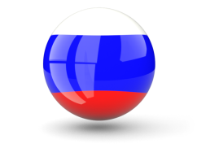
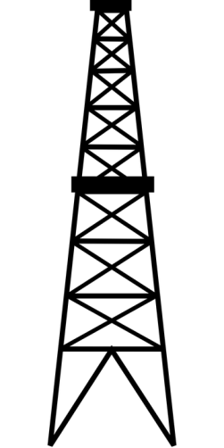
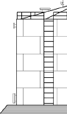
Russian Gas is more cost competitive than US LNG for European countries
8 $/MMBTU
4 $/MMBTU
0.5 | Regas. and withdraw
0.5 – 1.5 | Shipping to Europe
3.0 | Tolling fee*
0.5 | Transportation cost ~ 15% HH
Transport to Europe | 2.0
2.0 – 4.0 | Wellhead price ~ Henry Hub
Mineral Extraction Tax + Export Duty Tax (30%)* | 1.5
Wellhead price | 0.1 – 0.5
Sources : ENGIE Market Analyst
*Brent @60 $/BBL and 65 RUB/$
Sources : Cheniere & Platts
*Fixed cost
Notes:
It is important to accomodate competition between Russian gas and US gas. All the more that Short term marginal cost of US gas can lower Russian prices if Russia is playing a competitive game.
Countering America’s Adversaries Through Sanctions Act
SEC. 257. UKRANIAN ENERGY SECURITY. (a) STATEMENT OF POLICY.—It is the policy of the United States—
(8) to work with European Union member states and European Union institutions to promote energy security through developing diversified and liberalized energy markets that provide diversified sources, suppliers, and routes;
(9) to continue to oppose the NordStream 2 pipeline given its detrimental impacts on the European Union’s energy security, gas market development in Central and Eastern Europe, and energy reforms in Ukraine; and
(10) that the United States Government should prioritize the export of United States energy resources in order to create American jobs, help United States allies and partners, and strengthen United States foreign policy

Slide 8
Without NS2, European customers would pay a huge burden
With Ukrainian transit
Impact
0.5 - 2.5 $/MMBTU
EU-28 Gas Consumption
450 Bcm/year
Sources : ENGIE Market Analyst
Potential burden
for EU-28
6 - 24 Bn€/year
Notes:
Not easy exercise
Depending on the global market tightness.
Potential huge cost for European households and businesses.
For France only : one tenth of these figures.
On the LNG side, no issues.
On ne gas side : which route ?

Slide 9
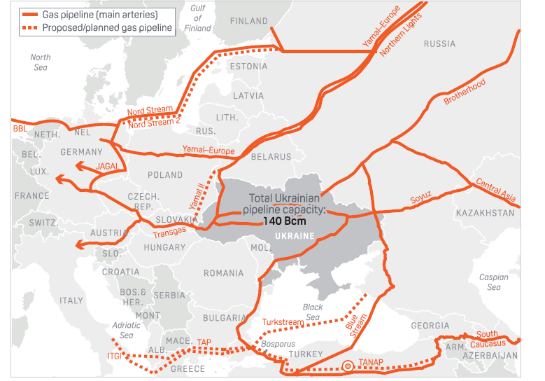
Diversification of Russian gas supply routes to Europe
Russian Pipe Exports
200 Gm³
NS1
57 Gm³
Yamal
42 Gm³
Ukraine
87 Gm³
West
65 Gm³
South-East
22 Gm³
Blue Stream
15 Gm³
Notes:
What we want as Engie is reliability.
Let’s be blunt, the Ukranian route is the most sensitive.
ENTSOG study.
Adding a new route is a way to diversify the risk. Normally nobody could contest this.
As regards the fact that NS2 is circonventing Ukraine. We do not deny it. It is argued that this is to deprive Ukraine from transit revenues. True, but I would like to remind that NS2 has not been decided in reaction to Maidan or in the wake of Russian aggression towards Ukraine.
Let’s take a step back in 1991 at the end of the Soviet Union.
Russia is not doing differently here than Algeria or even Norway to have a direct access to its end markets.

Slide 10
Need for 40 Bcm of gas transit through Ukraine to fill the gap
Sources : ENGIE Market Analyst
Notes:
We believe that the debate is not NS2 or the Ukrainian transit, but NS2 and the Ukrainian transit.
The Ukranian transit will remain. It will not be dismantled. It will attract some Russian gas. The question is how much and at which price.
This is a question still open.
Our believes …
But a situation which not easy :
Naftogas is always asking for more.
Ukr government not yet appointed
Russia that will not loose face in this game
US there to back Ukraine by trying to prevent on NS2
Europe that is devided and powerless to address the issue.

Slide 11
Takeaways
Greater dependency of Europe on gas imports
Market integration and competition are key to make gas secure and affordable
Competition between LNG and Russian gas is key
Nord Stream 2 contributes to the European market integration and diversification of supply routes…
  … not at the expense of Ukraine whose future relies on becoming a net gas exporter to Europe, integrating the European market with a free market regulatory regime and directing investments to energy efficiency.
  … nor at the expense of LNG imports, if they prove to be more competitive

Slide 12
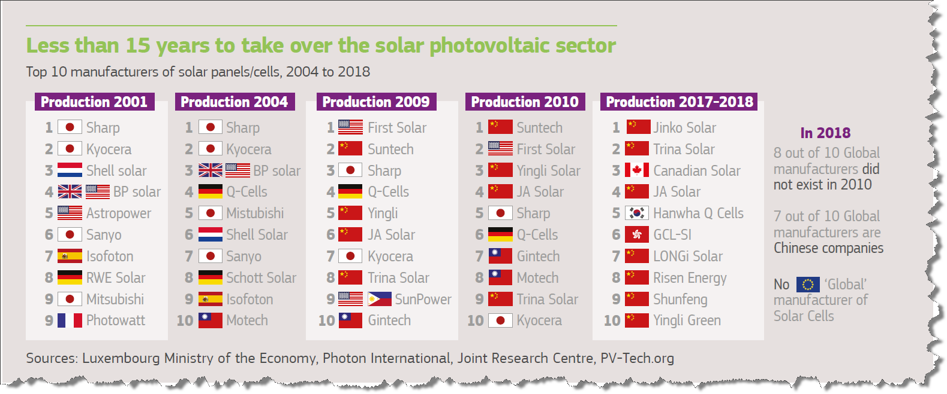
Dependencies of the future are certainly elsewhere…

Slide 13
Annexes

Slide 14
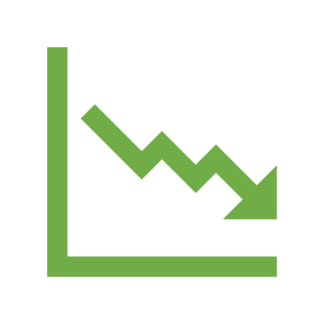

Natural Gas in the European energy mix
BP Statistical Review Outlook 2019
521 Bcm
Enerdata 2017

Slide 15
European gas market is making the competition work
Sources : ENGIE Market Analyst
US LNG to Europe : HH*115% + 3 $/MMBTU [liquefaction] + 0.5 $/MMBTU [shipping] + 0.3 $/MMBTU [regaseification]

Slide 16
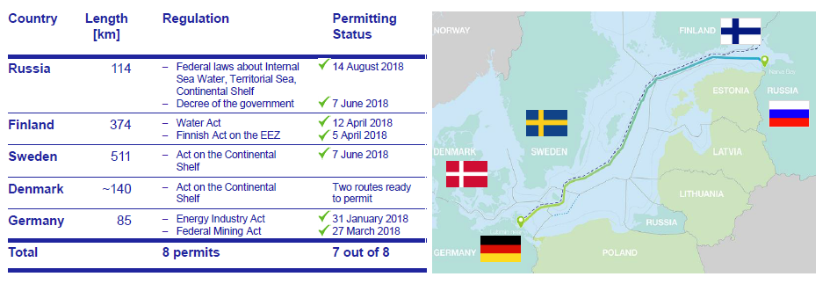
Permits Received in 4 of 5 Countries

Slide 17
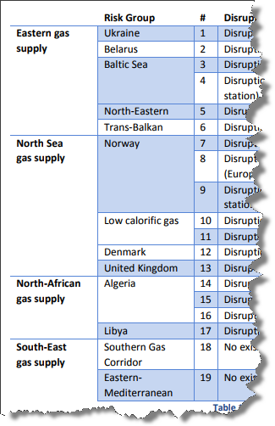
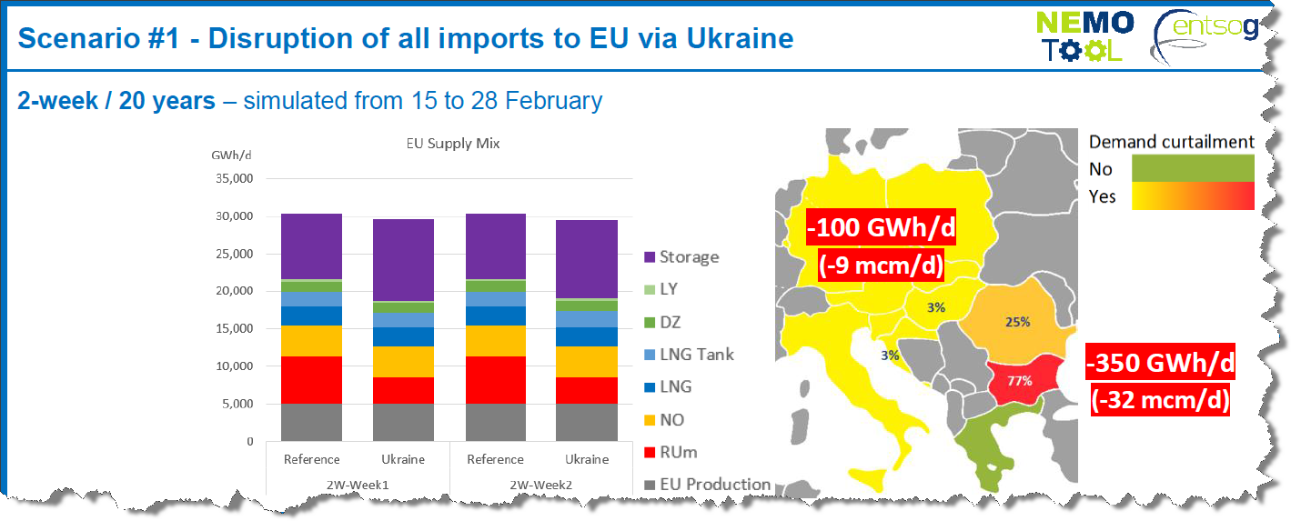
Preventing NS2 to be built will not improve European energy security
SoS : Security of supply regulation 2017 /1938
➔ Risk groups identified for 4 gas supply corridors
Requirement for Member State Authorities :
Share of common and national risk assessment
Setup of the solidarity mechanism measures
Notification of preventive action plans & emergency plans
Agreement defining the technical, financial and legal provisions for the solidarity mechanism
European Network of Transmission System Operator for Gas (ENTSOG) involved in the simulation :
The last ENTSOG study confirms that the Ukrainian transit flow interruption is the worst scenario for Europe

Slide 18
US LNG already competing on European markets

Slide 19
NS2 is the cheapest route for end consumers
Cost to ship gas from Russia
to Germany - Waidhaus in 2019
via Ukraine $/1000 m3 |  |  |  | via Baltic $/1000 m3
Ukrainian TSO | Current Tariff applied till end 2019 | Theoretical Tariff (not applied but published in 2015) | Proposed new Entry-Exit Tariff (in Nov 2019 by UA regulator) | Nord Stream* | Current Tariff
 | 33.8 | 52.6 | 30.2 |  | 25.2
Slovakian TSO | 7.0 | 7.0 | 7.0 | German TSO | 6.9
Czech TSO | 5.6 | 5.6 | 5.6 | Czech TSO | 5.6
Total | 46.4 | 65.2 | 42.8 |  | 37.7
> 23 % more expensive
Sources : ENGIE Market Analyst
* According to A. Miller, CEO of Gazprom mentioning 2.10$/mcm/100 km in TASS Russian News Agency
With USD/EUR = 1.13, CZK/EUR = 26, GCV = 10.6 kWh/m3, NCG (2019) = 22.7 €/MWh

Slide 20
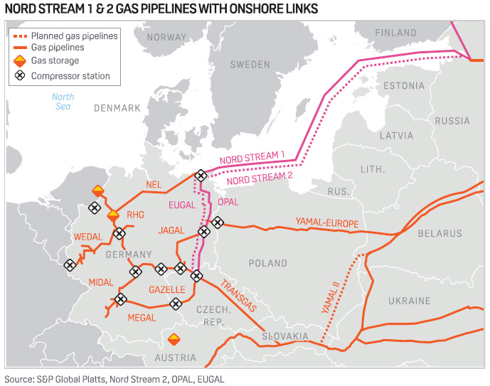

Slide 21
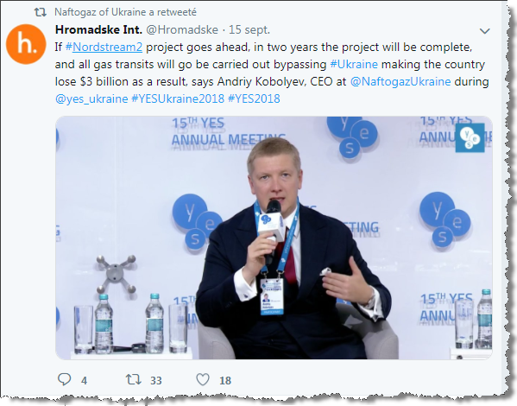
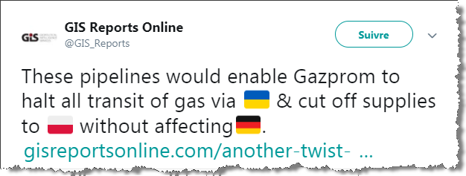
Misconception on Gas Transit business

Slide 22
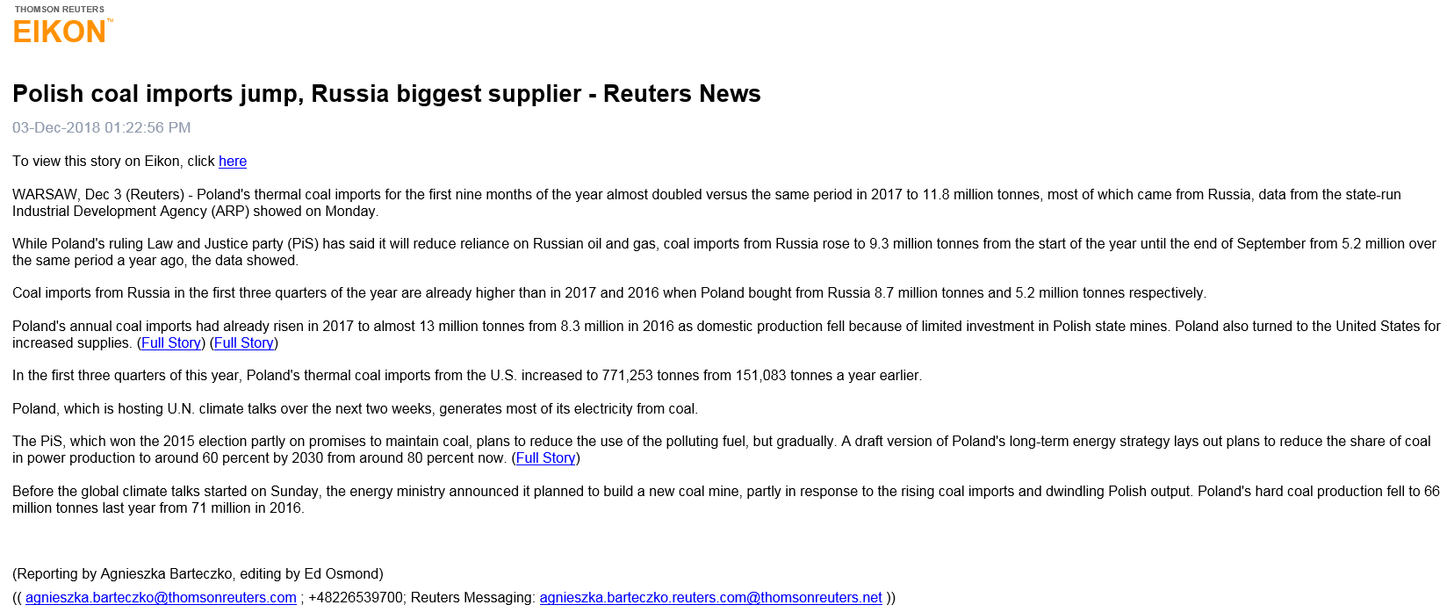
Other dependencies vs. Russia

