Slide 1
Green Horizons
What’s New at the Energy–Climate Nexus
Workshop Gas Chair September 26th 2025
Anna Creti

Slide 2
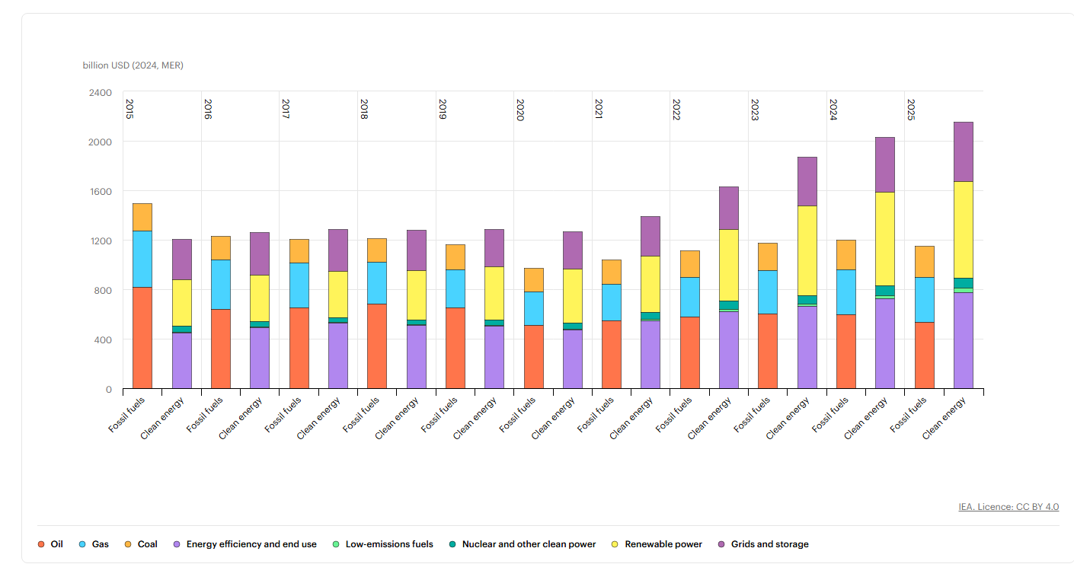
Green horizons: rebound in clean energy investment (IEA, 2025), but not yet on track to deliver on the renewable and efficiency goals agreed at COP28
IEA, 2025

Slide 3
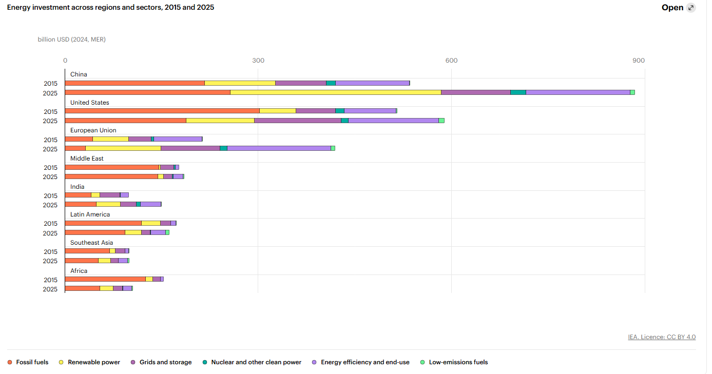
After the Paris Agreement, China takes the lead
IEA, 2025

Slide 4
The Big Picture: Three Shifts
From incremental to structural: electrification and digitalization reshape demand and system design
From cheap capital to selective capital: cost of finance now a key driver of levelized costs
From mitigation-only to dual track: mitigation + resilience/adaptation in energy planning

Slide 5
Power Systems: New Tipping Points?
Record renewable additions; solar as marginal price setter in more hours
Thermal fleets shift to flexibility; capacity markets expand
Storage scales beyond pilots; curtailment and queues matter
Grid bottlenecks now critical path
Demand is Changing: AI, EVs, Heat Pumps
Data centers & AI create localized load surges
EV uptake accelerates; charging standards converge
Heat pumps expand; hybrid systems manage peaks
Demand flexibility becomes a resource

Slide 6
Industry: From Pilots to Pipelines
Green steel, low‑carbon cement, electrified heat
Scope 3 pressure; product standards (e.g., CBAM)
CCS vs process redesign trade‑offs
Hydrogen: Fit‑for‑Purpose
Focus narrows to hard‑to‑abate sectors
Cluster strategies; derivatization (ammonia/methanol)
Certification frameworks mature; offtake de‑risks projects

Slide 7
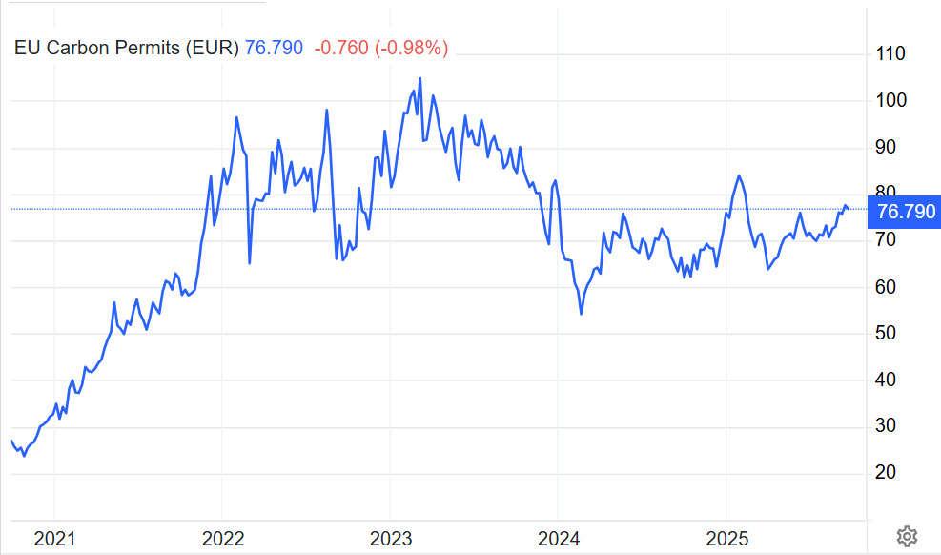
EU ETS: the perimeter game
Prices averaged ~€80–90/tCO₂ in 2023
Tightening cap and broader coverage anchor long‑term signals
Interacts with power market reform and CBAM roll‑out
EU ETS 2: wait and see

Slide 8
Research trends (I) with empirical focus
FACTS
Climate change significantly enhances energy security risk.
Extreme events, measured by the total losses caused by extreme temperatures and the number of extreme temperature events, are also associated with a significant rise in energy security risk.
Security of supply: interacts with policy and geopolitical uncertainty; from gas to critical materials
QUESTIONS
Can Investment in clean energy significantly reduce the impact of climate change on energy security risk?
Are there concerns about energy security in the long term (IPCC scenarios)?
How trade risks associated with fossil fuels and critical materials evolve with low-carbon paths?

Slide 9
Research Trends (II) with IO focus
FACTS
Industrial policy is justified by spillovers & scale
Market structure shapes emissions outcomes
Risk management is critical for heavy industry
Spatial and strategic considerations are central
QUESTIONS
Strategic R&D races in cement & hydrogen?
Rent-sharing: who captures decarbonization gains?
Model “policy risk” in long-lived industrial assets: how do firms hedge or adapt to changing public opinion?
International rivalry & trade in green tech (CBAM, IRA)?

Slide 10
Themes to watch (I)
Spatial competition and policy interactions in fuel / energy markets are active research topics, especially how tax / subsidy changes affect firms and consumers regionally.
Investment under uncertainty (delays, time to completion) is being formalized more richly in sequential models. That has direct relevance to large industrial decarbonization projects with long lead times.
Efficiency studies in network industries remain relevant (electric distribution). For decarbonization, similar methods could be adapted for CO₂ transport networks, grid infrastructure, etc.
The data availability on energy systems, satellite data, firm-level data, and ML methods opens new methods in empirical energy economics.

Slide 11
Themes to watch (II)
Methane emissions
  Methane abatement is a critical short-term climate lever.
  Technology is advancing (satellite detection, AI, continuous sensing).
  Costs remain modest up to a point, but financing and policy gaps persist.
  Industrial economics can play a role in incentive design, regulation, and coordination
Biogenic CO2
  Biogenic CO₂ capture/utilization is small but growing.
  Technologies exist but need scaling, infrastructure, and clear policy support.
  Industrial economics: market power, incentives, certification critical.
  Opportunity: integrate biogenic CO₂ in industrial clusters to accelerate net-zero.

Slide 12

Green Horizons
What’s New at the Energy–Climate Nexus…let’s go!

